Slide 1
Industrial Project (234313) “Arabot”: Develop a voice recognition feature for Madrasa’s online
Students: Bothaina Karakrah, Maysa Zbidat.
Supervisors: Nadav Wachs, Yaniv Gershon.

Slide 2
Goals
Complete instructor interface in which an instructor can create, design and implement scripts as an HTML component in the Open EdX system. The interface does not require using code to create the scripts.
An easy-to-use responsive platform in which a user can communicate and converse with a chatbot.

Slide 3
Methodology
We completed the instructor interface, designed to allow non-coders to design scripts and implement them easily in the Open EdX system, then at the end we designed and styled the website.

Slide 4
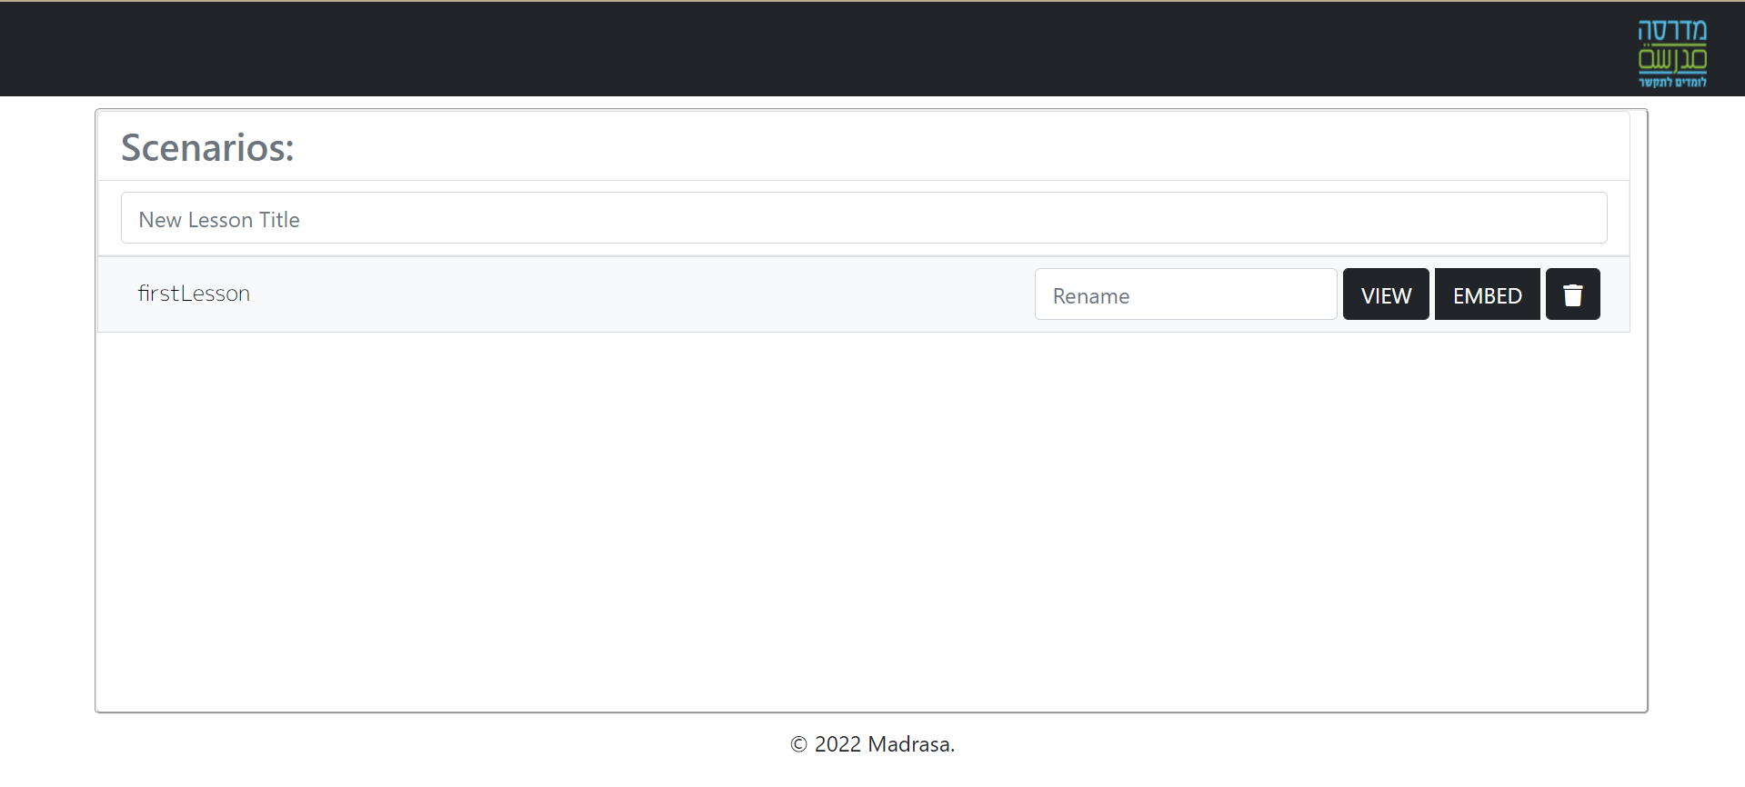
Achievements
We create Scenarios list that contains all the Scenarios beside optional buttons, so he can create more than one scenario:

Slide 5
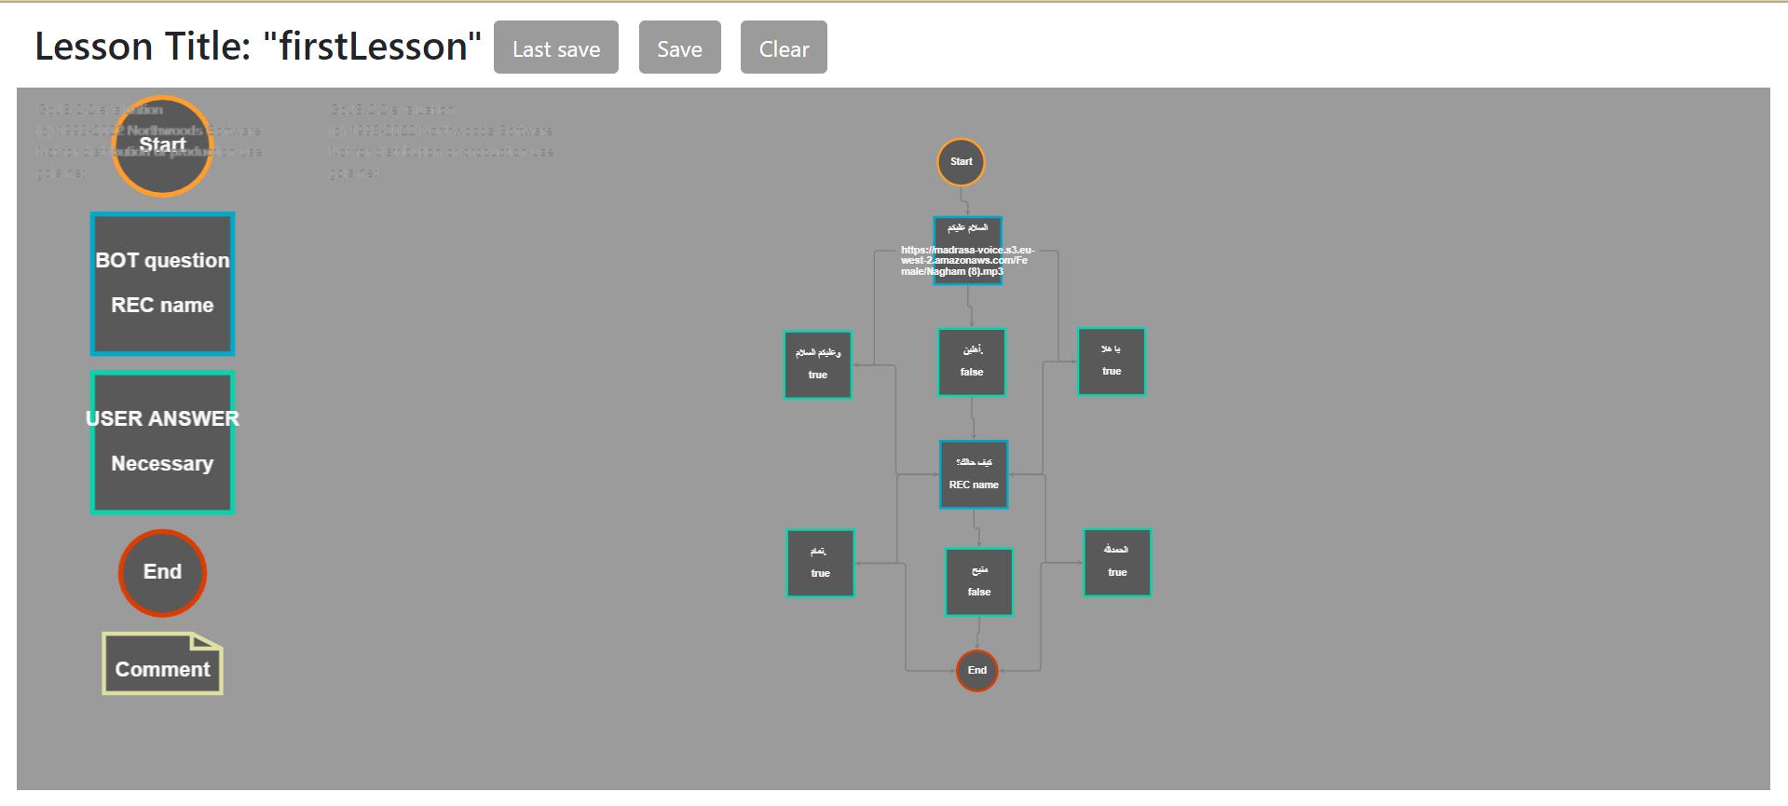
Achievements
Complete instructor interface, so he can create new lessons without learning code.

Slide 6
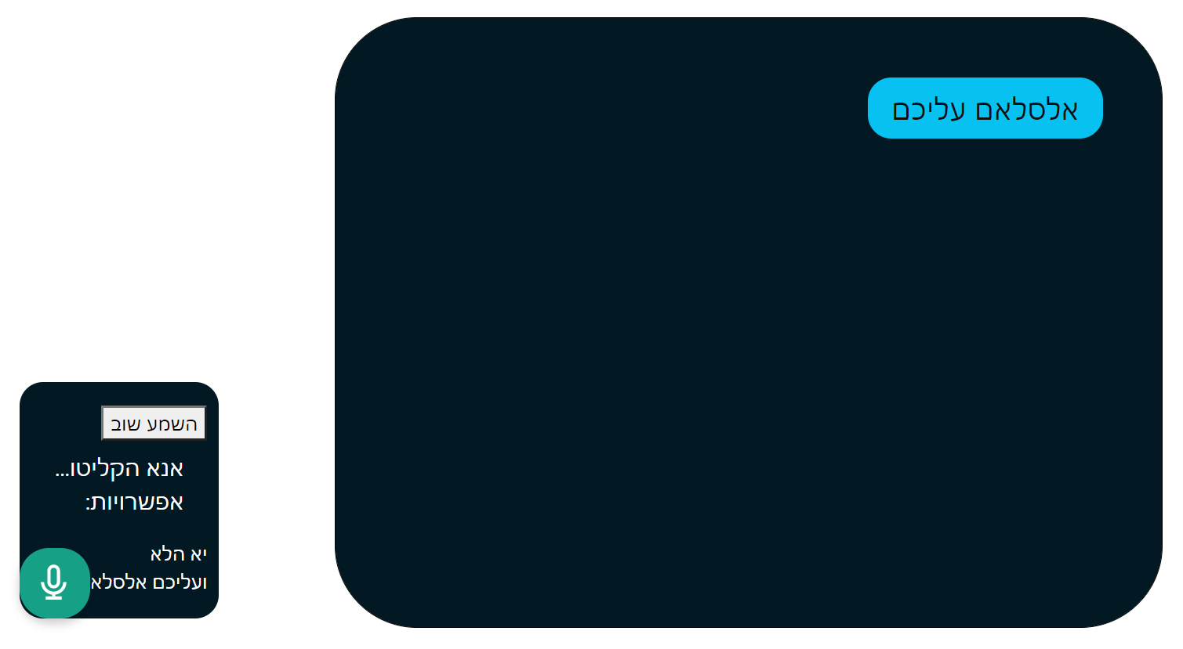
Achievements
Create An easy-to-use responsive platform

Slide 7
Achievements
“Rename” input, so the instruction can change the title of the scenario.
“EMBED” button - give the instructor possibility to add the previous chat in “Madrasa” website by copying <iframe> code that contains the URL of the scenario.
Trash icon – Delete the scenario from the database. When clicking the icon an alert appears to avoid accidently deleting.

Slide 8
Achievements
fixed the bugs that caused from the API library – annyang.
Deploy the web using Heroku and mongoDB atlas:
https://damp-cliffs-79512.herokuapp.com/

Slide 9
Conclusion
The website we created will give the instructor ability to create new lessons and include them in other lessons so the student can actively engage in conversation while practicing language production.

Slide 10
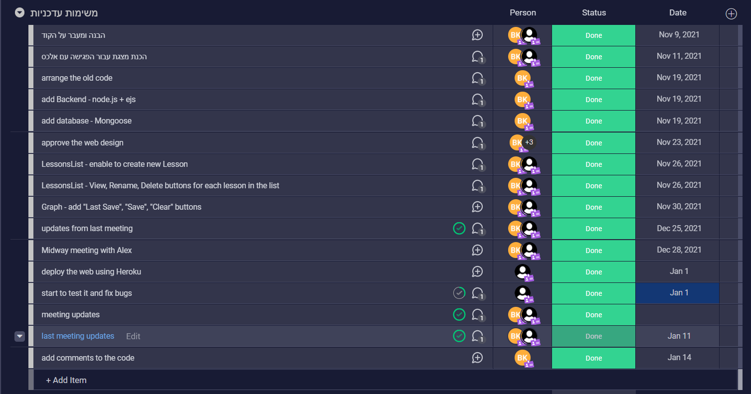
A recap of the progress in the project during each week of the semester:

